Slide 1

Beta Sprint
Team FLUX
Notes:
Hello here’s team geeks, and we are finally here to give a presentation on what we have done throughout our beta phase.

Slide 2
01
Task Progress
Contents
02
Gains & User Feedback
03
Project Showcase
Notes:
Today I will give a short intro on our Task progress, with a project showcase, then what we have gained from this journey.

Slide 3
01
PROGRESS
Notes:
First, I will talk about what we have done and also, what’s leftover.

Slide 4
Progress
Showcase
Gains
What we’ve done:
Plan | Completed?
Deployment on cloud server | Y
Platform optimization | Y
Data security test | Y
Interface optimization | Y
User test and further improvement | Y
Back-end function test | Y
Community development | Under going
Notes:
Here is what we have done: we have finished deployment on a cloud server, which is more time consuming than we’ve expected, but now the good news is that our system is accessable on the internet, which is a huge step up to our users. We’ve also done some tests including automated singleton function test, white box test and black box test, in order to make sure the critical function of the system is robust enough to support our project. With suggestions given from our users, we have done some interface improvement and debugging, aiming to provide a better system interface. Finally and unfortunately, our dedicated android program with further community development is still under development.

Slide 5
02
GAINS
Notes:
after I finish the last part about what we have gained.

Slide 6
Progress
Gains
Showcase
During the BETA sprint, each team member had some unique experiences and gains:
A.
Take a deep dive into server architecture and learn how to integrate them into an efficient system. This includes operating system, database, network and security Settings.
B.
Pay more attention to the details of user feedback. Through testing, a deeper understanding of the user's feelings in use. This experience has improved my testing ability.
C.
Learned responsive design and development of JAVA backend applications, as well as functional and interface testing of VUE frontend applications.
D.
Learned how to set up connections and communications between backend ,frontend and AI We then perform system-level tests.

Slide 7
Progress
Gains
Showcase
E.
Risk assessment skills were trained to take appropriate action to address security vulnerabilities discovered. Improved emergency response capacity.
F.
Understand the need for information security. Learned a variety of information security technologies.
G.
Need to learn to collect user feedback and suggestions and understand user needs. Understand that better results can only be achieved by working together and communicating.
H.
It shows the improvement of technical capabilities, and the ability to more fully solve the front and back end and ai processing part of the interaction problems
I.
Improved user research skills and provided clearer direction for product iteration.

Slide 8
03
PROJECT
SHOWCASE
Notes:
Now I will have a showcase on our project.

Slide 9
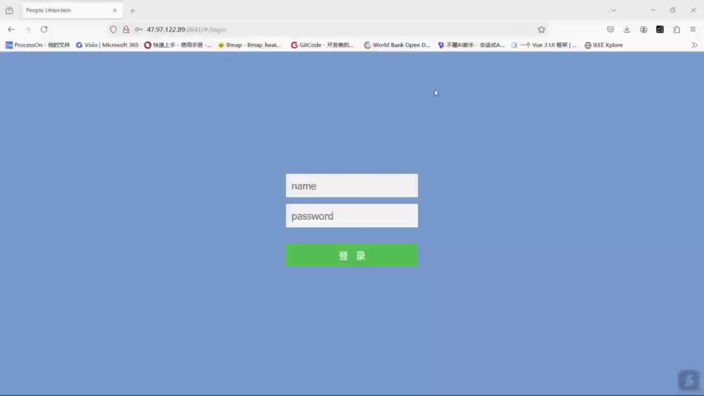
Progress
Gains
Showcase
Notes:
I want to give you some brief idea of our system structure using a video.
The video is recorded in hurry so it might not be able to completely display the functions of our system. Feel free to ask me any questions ---- after

Slide 10
Thanks to ALL

